Slide 1
Introduction of SUMO
2019-08-16
報告者:顏慷

Slide 2
What is SUMO?
"Simulation of Urban MObility" (Eclipse SUMO) is an open source, highly portable, microscopic and continuous road traffic simulation package designed to handle large road networks.

Slide 3
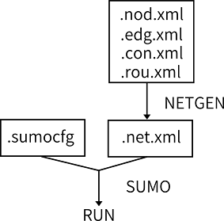
Simulation Reference File Types
<vehicle id=“1” type="truck" depart="0.0">
<route edges= “edge1 edge2"/>
</vehicle>

Slide 4
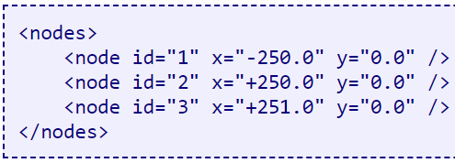
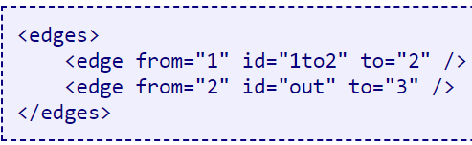
SUMO Files- Nodes and Edges
3
1
2

Slide 5
SUMO Files- Routes
<vehicle id=“1” type="truck" depart="0.00">
<route edges= “edge1 edge2"/>
</vehicle>
3
1
2

Slide 6
SUMO Files- Configuration
<?xml version="1.0" encoding="UTF-8"?>
<configuration xmlns:xsi="http://www.w3.org/2001/XML"
<input>
<net-file value="map.net.xml"/>
<route-files value="map.rou.xml"/>
</input>
<time>
<begin value="0"/>
<end value="10000"/>
</time>
</configuration>

Slide 7



SUMO Function
Simulation.convertGeo()
Vehicle.getPosition()
Simulation.getDistance2D()
(22.99, 120.21)
(400, 300)
10km
(400, 300)
(0, 0)
7.2 km
(300, 200)

Slide 8
SUMO Function (cont’d)
Simulation.convertRoad()
Vehicle.getRoad()
Simulation.findRoute()
Vehicle.setRoute()
Vehicle.setStop()
(edge3)
(22.99, 120.21)
(edge1, pos=5.0)
(edge1, pos=10.0)

Slide 9
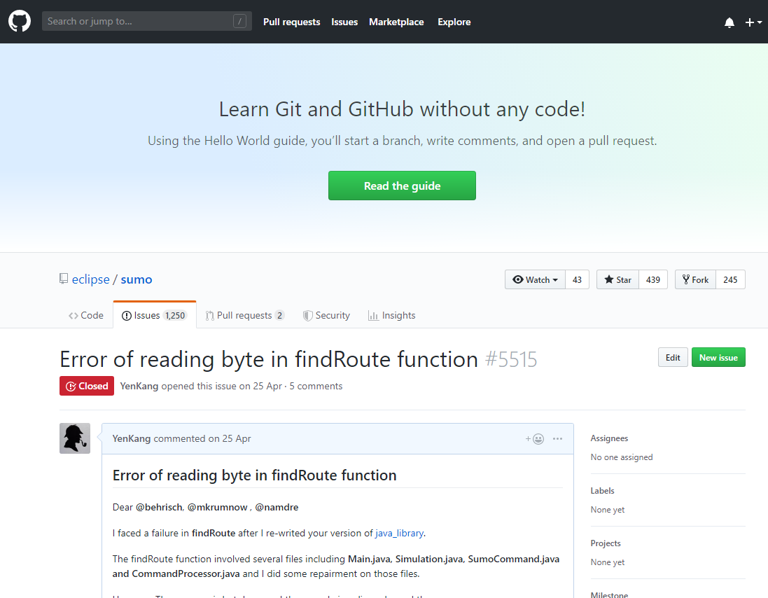
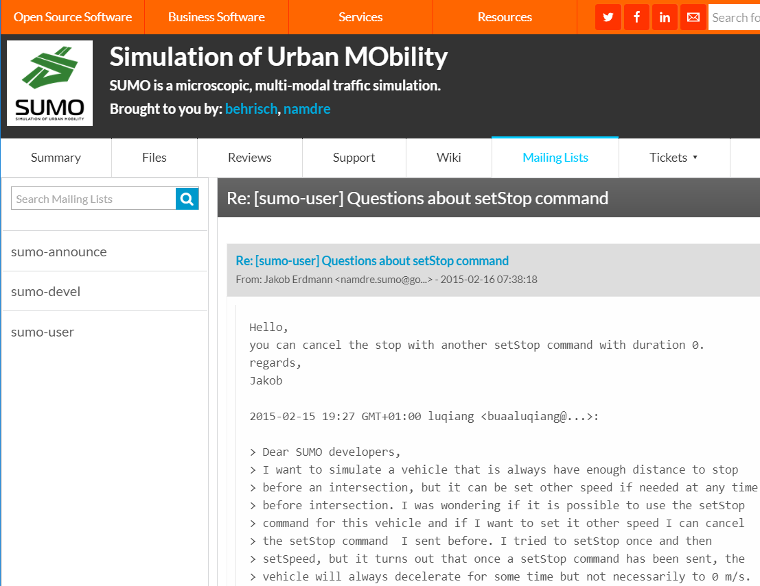
Question Channel

Slide 10
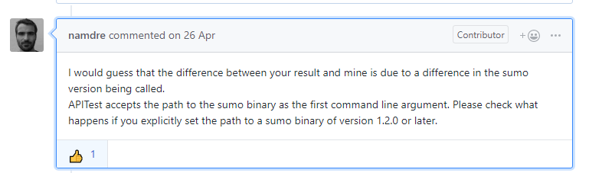
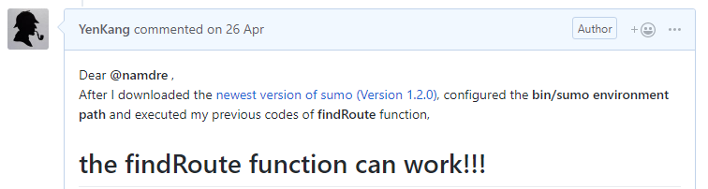
Question Channel (cont’d)

Slide 11
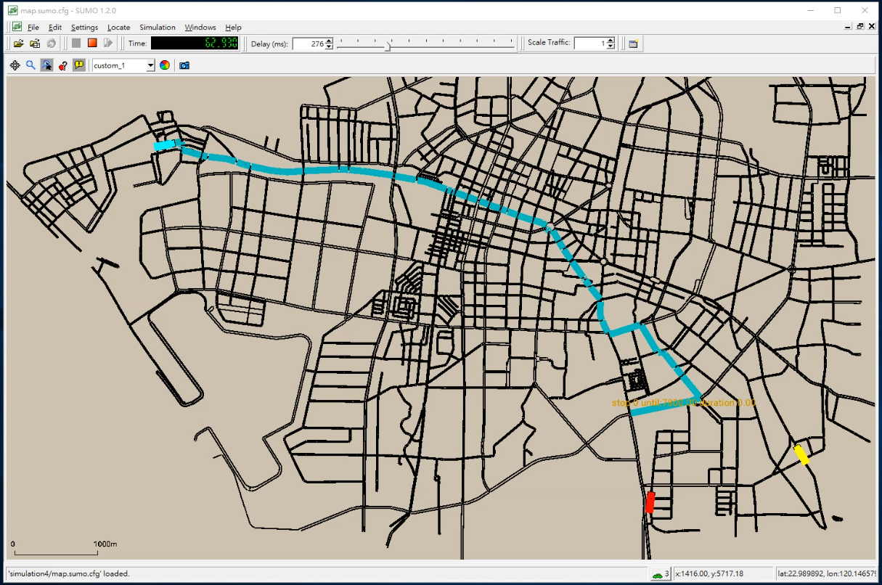
SUMO Visualization
Stop
TimeSeconds
Stop until
2400
Vehicle
coordinate
Longitude, Latitude

